Slide 1
Projects Summary
Collaborations
MYOu collaboration => One paper to be submitted + another one ongoing (bounced back from referees several times).
YXQian collaboration => See dedicated slides.
XFGuo => Two papers are in preparation.
Own project
RMCP2P GUI developing
FGT 2D magnetic material => See dedicated slides.
Graphitized carbon => See dedicated slides.
CeriaNano => Reprocess with BBEST.

Slide 2
FGT – Equations concerning real- and reciprocal space magnetic signal
Reciprocal space [1]:
Real space [2, 3]:
Spin self-scattering term, which appears as a peak at very low r.
[1] Refer to RMCProfile manual section-2.10.2.
[2] B. A. Frandsen, et al., Acta Cryst. (2014). A70, 3-11.
[3] B. A. Frandsen, et al., Phys. Rev. Lett. (2016), 116, 197204.

Slide 3
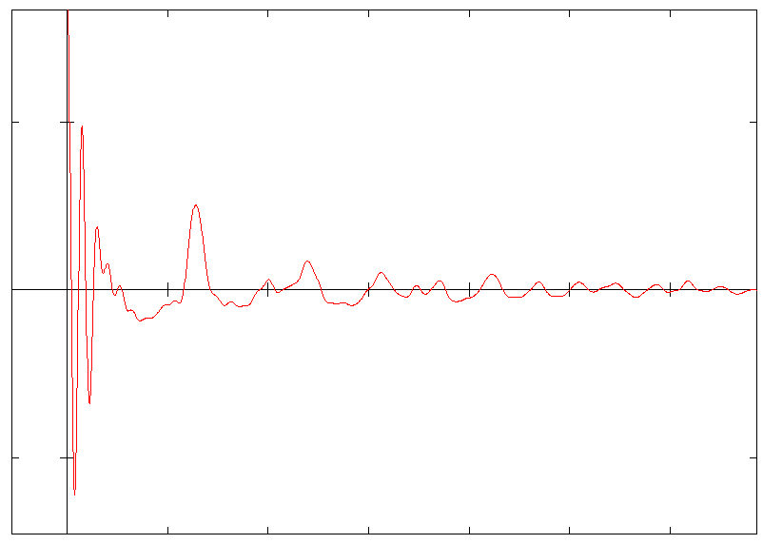
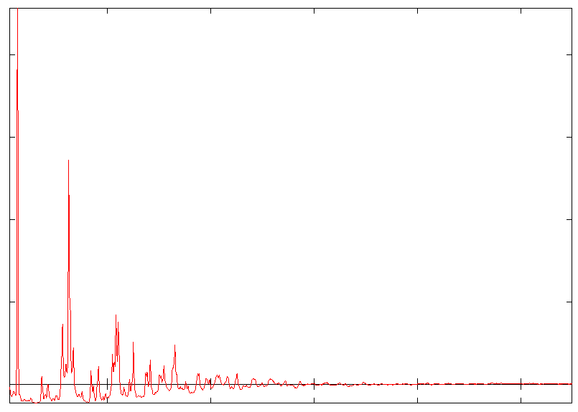
FGT – Equations concerning real- and reciprocal space magnetic signal
Real-space
Reciprocal-space

Slide 4
FGT – 300 K RMC
Low-Q region is excluded here, refer to next slide for rationale.
Small box (8x8x5 supercell) was used here for testing purpose, so the calculation seems not smooth. The system only contains 7390 atoms. Also, the maximum value of calculation in r-space only extends to ~16 Å.

Slide 5
FGT – 300 K RMC
Rationale for excluding low-Q region from the data:
By excluding the low-Q region, for sure we will lose some long-range correlation information. In this specific case, we lose the correlation information along the long c-axis, which is basically about the arrangement of layers from the long-range point of view. However, losing such information does not kill our modeling and further analysis since anyways in this study we are only going to focus on the short-range ordering. Also, supposing we include the PDF up to 20 angstrom (considering how we set up the simulation box - though supercell is long in c-axis but the maximum calculation length is limited by a- and b-axis), we are still not reaching the cell parameter along c-axis (~30 angstrom). Therefore, excluding the low-Q region and thus losing the long-range correlation information in Q-space is consistent with what is included in r-space for the modeling. In another word, if we grab the configuration we obtain from current RMC fitting (assuming we get a good fit for all datasets currently used), we may not reproduce the originally excluded low-Q part of the S(Q) pattern, which means the model we obtain through RMC is not right. But it is not right only in terms of long-range correlation along c-axis!
To-dos:
Larger box
Low-Q included
Magnetic contribution to the model (paramagnetic ordering contributing to the low-Q blob)

Slide 6
FGT – 300 K RMC
Low-Q region is included, no magnetic contribution.
PDF fit is not as good as before (when low-Q region is excluded).
Obvious mismatch in the low-Q region for SofQ pattern – magnetic contribution from paramagnetic arrangement of moments

Slide 7
FGT – 300 K RMC
Low-Q region is included, magnetic contribution included. Here, identical constraint is used as that for the fit where no magnetic contribution is included.
PDF fit gets much better as compared to the case where no magnetic contribution is included in the model. This is not because magnetic signal is included in the PDF model, but instead it’s because when including magnetic signal in SofQ model, RMC is not trying that much to mess up the PDF pattern to get a good fit in Q-space.
Low-Q region of SofQ pattern gets better. Still mismatch there, which could be due to the wrong magnetic moments value used.

Slide 8
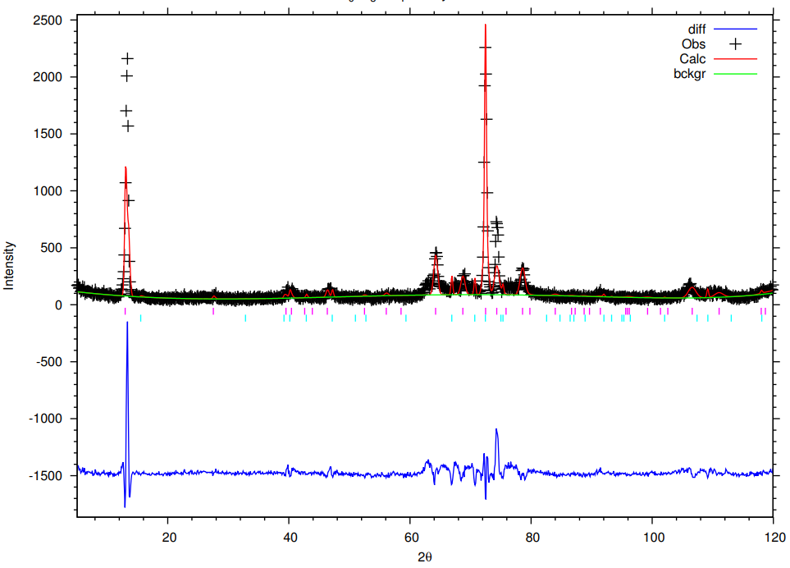
FGT – HB2A
GSAS refinement for 350 K data with two phases, the should features is not accounted by the side phase. Without considering stacking fault, it’s probably difficult to move forward per Bragg refinement concerns.

Slide 9
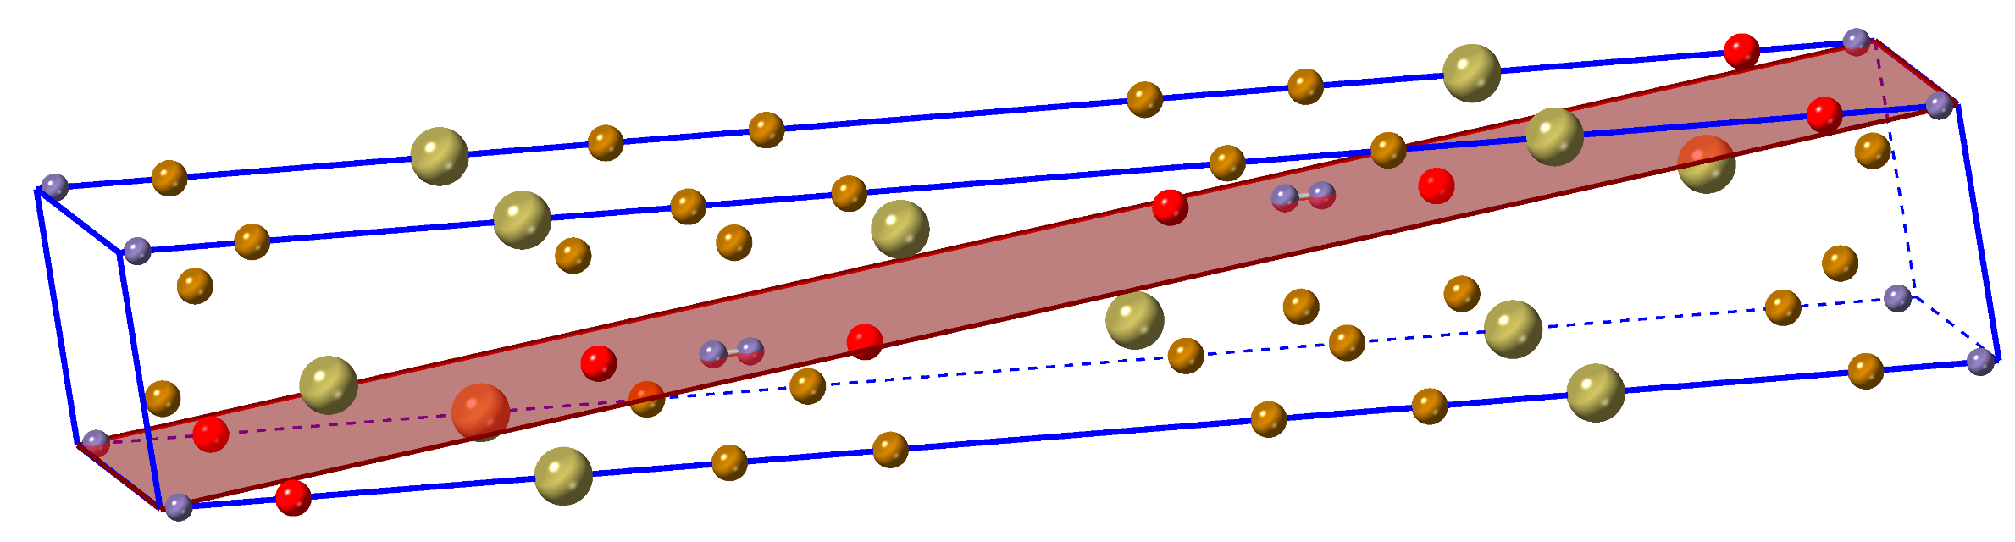
FGT – HB2A
[10-1]
The major magnetic peak change with T

Slide 10
Carbon - Background
Literally and traditionally, when we say hard carbon, we mean the mechanical hardness of carbon is strong.
However, nowadays the word “hard carbon” is used interchangeably with “non-graphitizable carbon”, which means certain carbonaceous materials not transforming into graphite even at temperatures higher than 3000 ℃.
Therefore, the “hard carbon” we mean now is not in close relation with the mechanical hardness of carbonaceous materials. For example, some carbonaceous materials with high mechanical hardness (traditionally hard) can be graphitized (i.e. considered to “soft”, in terms of graphitizability). Meanwhile, we also have carbonaceous materials with low mechanical (traditionally soft) which cannot be graphitized (considered to be “hard”, in terms of graphitizability).
Refer to the link provided below for detailed introduction [1].
[1] https://1drv.ms/b/s!AlZpbyasn9jtkcF61bVP7W1NQk5VAw?e=oE9r1P

Slide 11
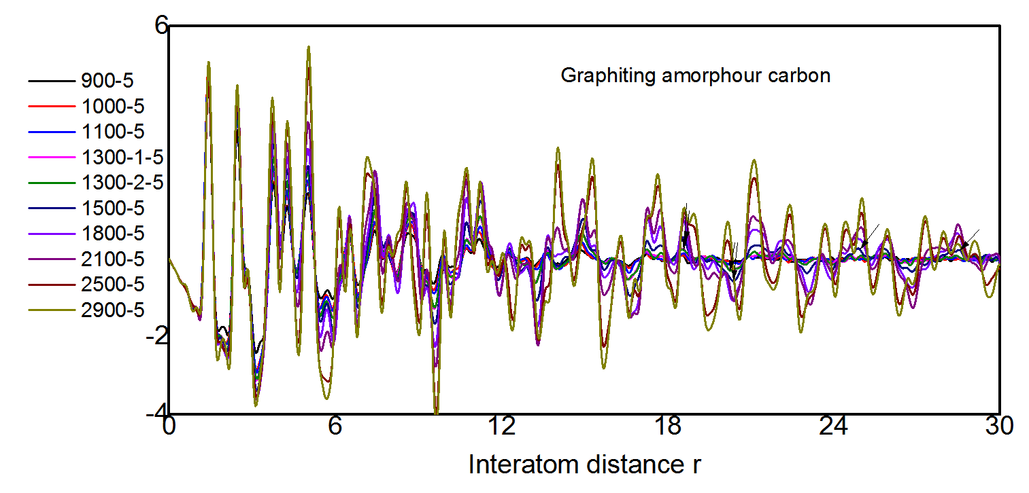
Carbon – Workflow
There has been report on graphitization of carbon using MD with REAXX potential, which marks a good starting for our simulation – combine MD with RMC for structural relaxation. Therefore, we chose to focus on soft carbon for this study.
Experimentally, we have PDF data for soft carbon with various annealing temperature, which show distinctive features in between different temperature.
Data from Mingyang Ou, considered as CONFIDENTIAL

Slide 12
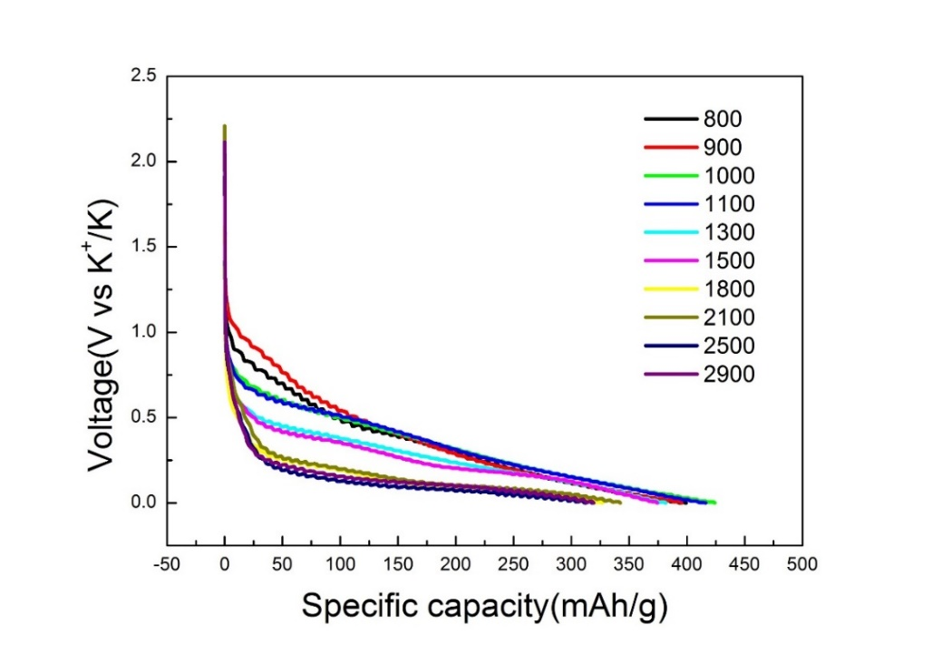
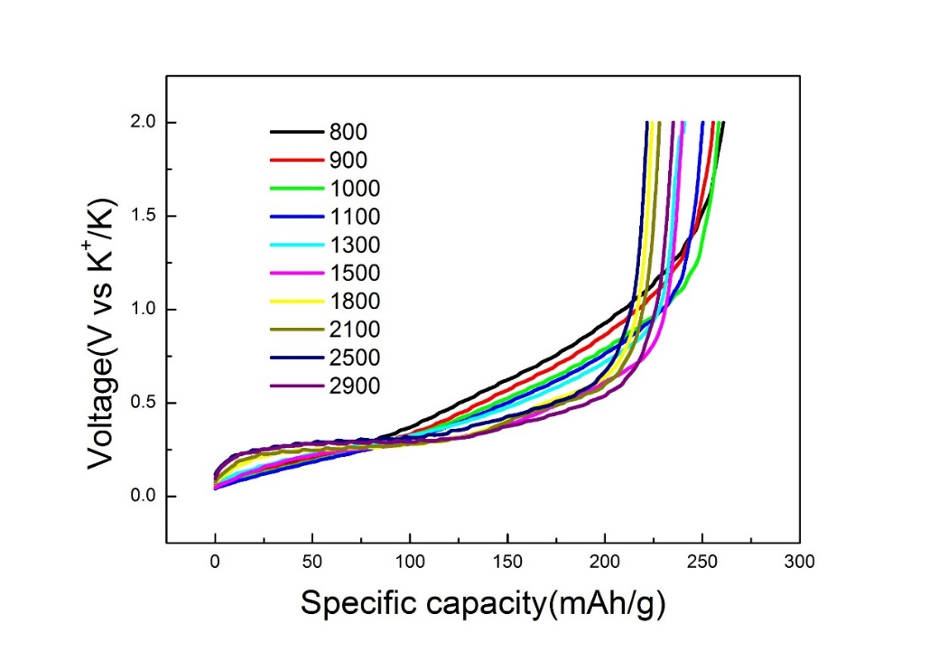
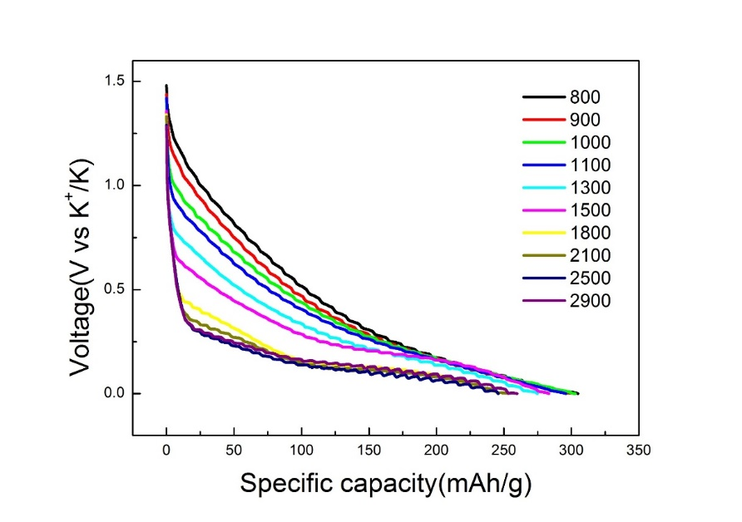
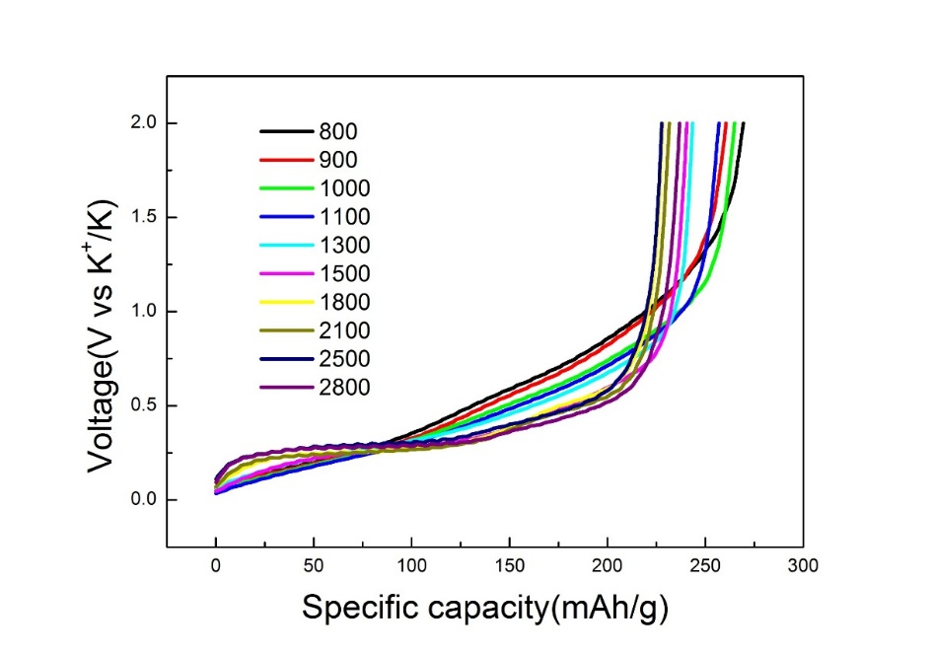
Carbon – Battery performance
Data from Mingyang Ou, considered as CONFIDENTIAL

Slide 13
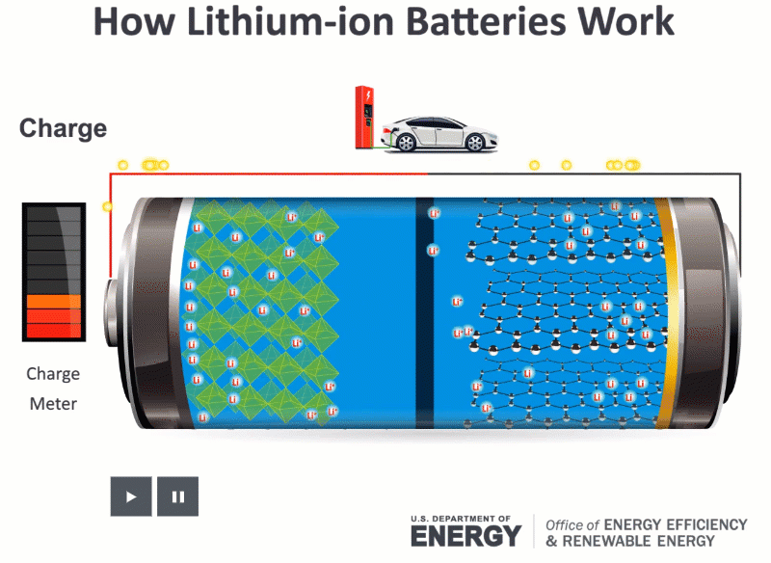
Carbon – Basics about battery
Use “slide show” to show the animation [1]
[1] https://www.energy.gov/eere/articles/how-does-lithium-ion-battery-work

Slide 14
Carbon – Basics about battery
There are several basic concerns for battery performance characterization – current rate (in brief, how fast battery charge/discharge), energy capacity (storage) and safety, etc.
Battery charge/discharge curve reflects basic property of battery. Usually the vertical axis is potential (cathode – anode, with the dimension of V) and horizontal axis is energy density (specific capacity, usually with dimension of mAh/g) and therefore the integration of the charge/discharge curve gives the energy.
Another major feature that can be directly told from the charge/discharge curve is the formation of dendrite. Usually when dendrite forms, the potential is usually around certain range. The formation of dendrite is usually the cause of explosion during charge since it can break the separator thus make the whole circuit short during charge. This is what we don’t want and therefore in the charge/discharge curve we want the potential as away from the dendrite formation region as possible.
Our goal is to use the structure technique to tell the structure and quantify structure property. Then we can use the obtained structure property to help us establishing the structural origins of electrochemical performance (typically, the charge/discharge curve itself, including the shape – slope & plateau & etc., the integration, etc.), safety (how close or far we get from the dendrite formation region), current rate (power or energy cell [1])
[1] https://www.evernote.com/l/AQo5DkLByCpDgpZHwqR27_Kt6YJwPzBP504/

Slide 15
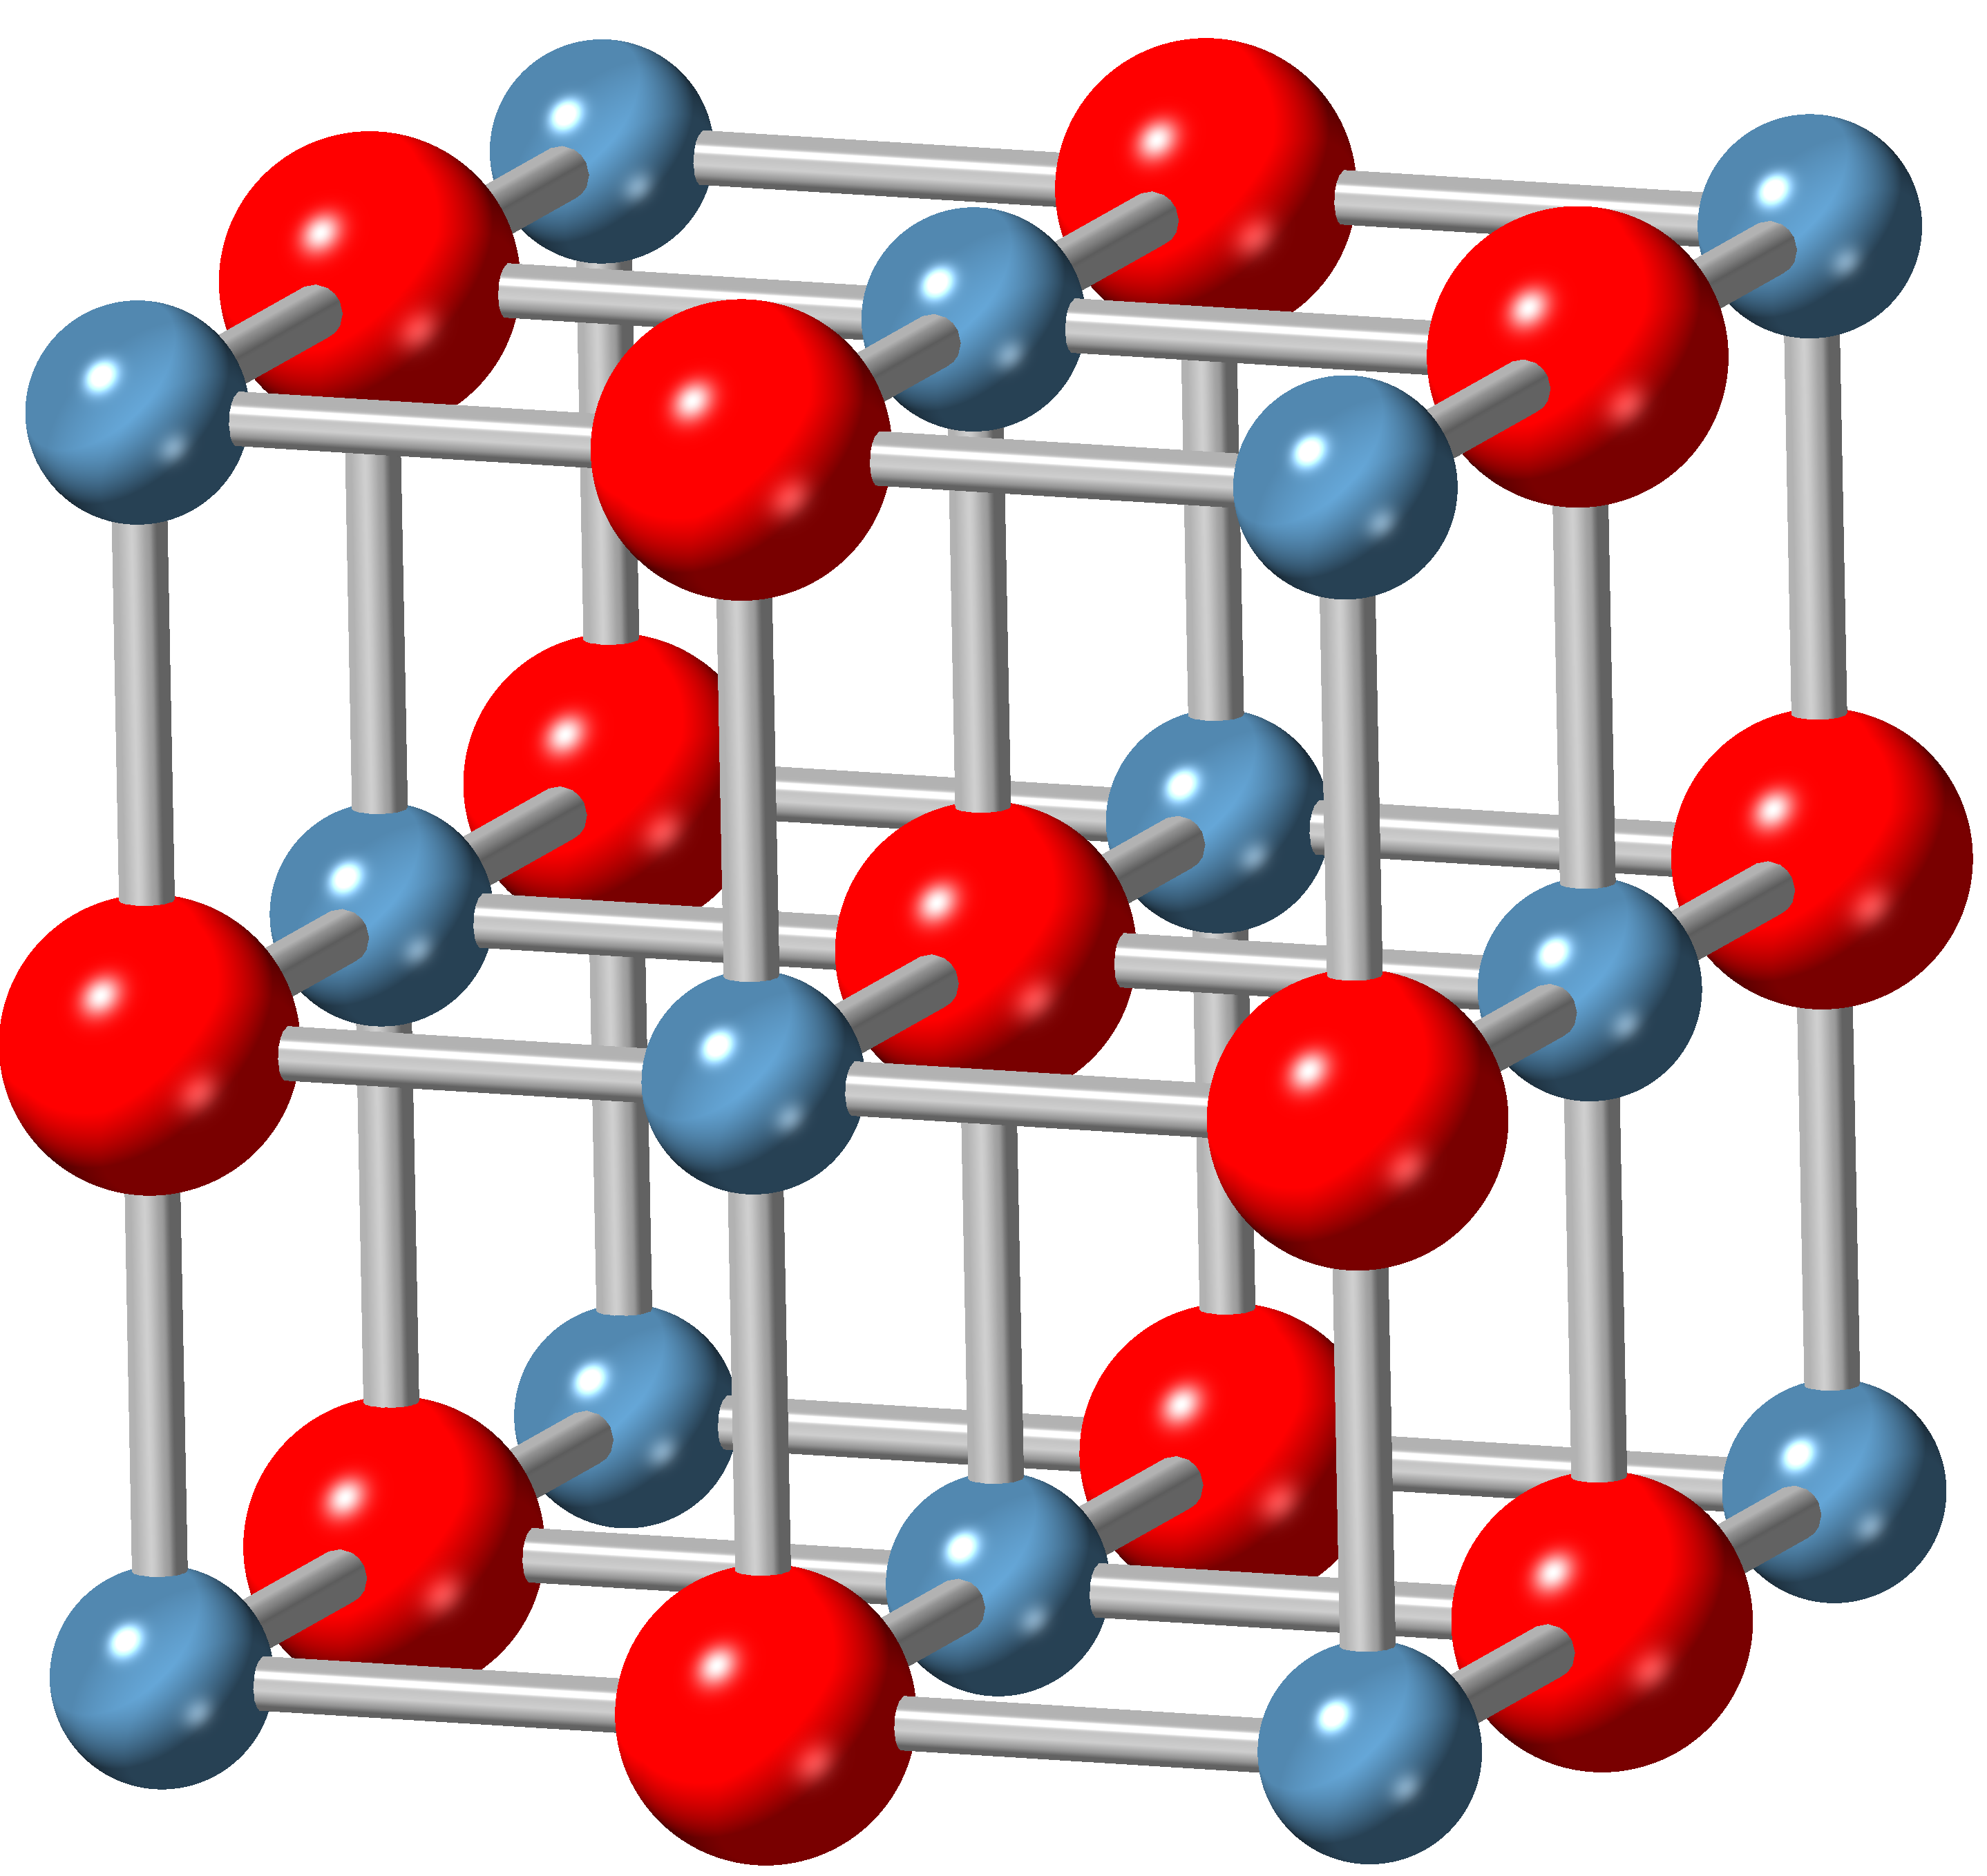
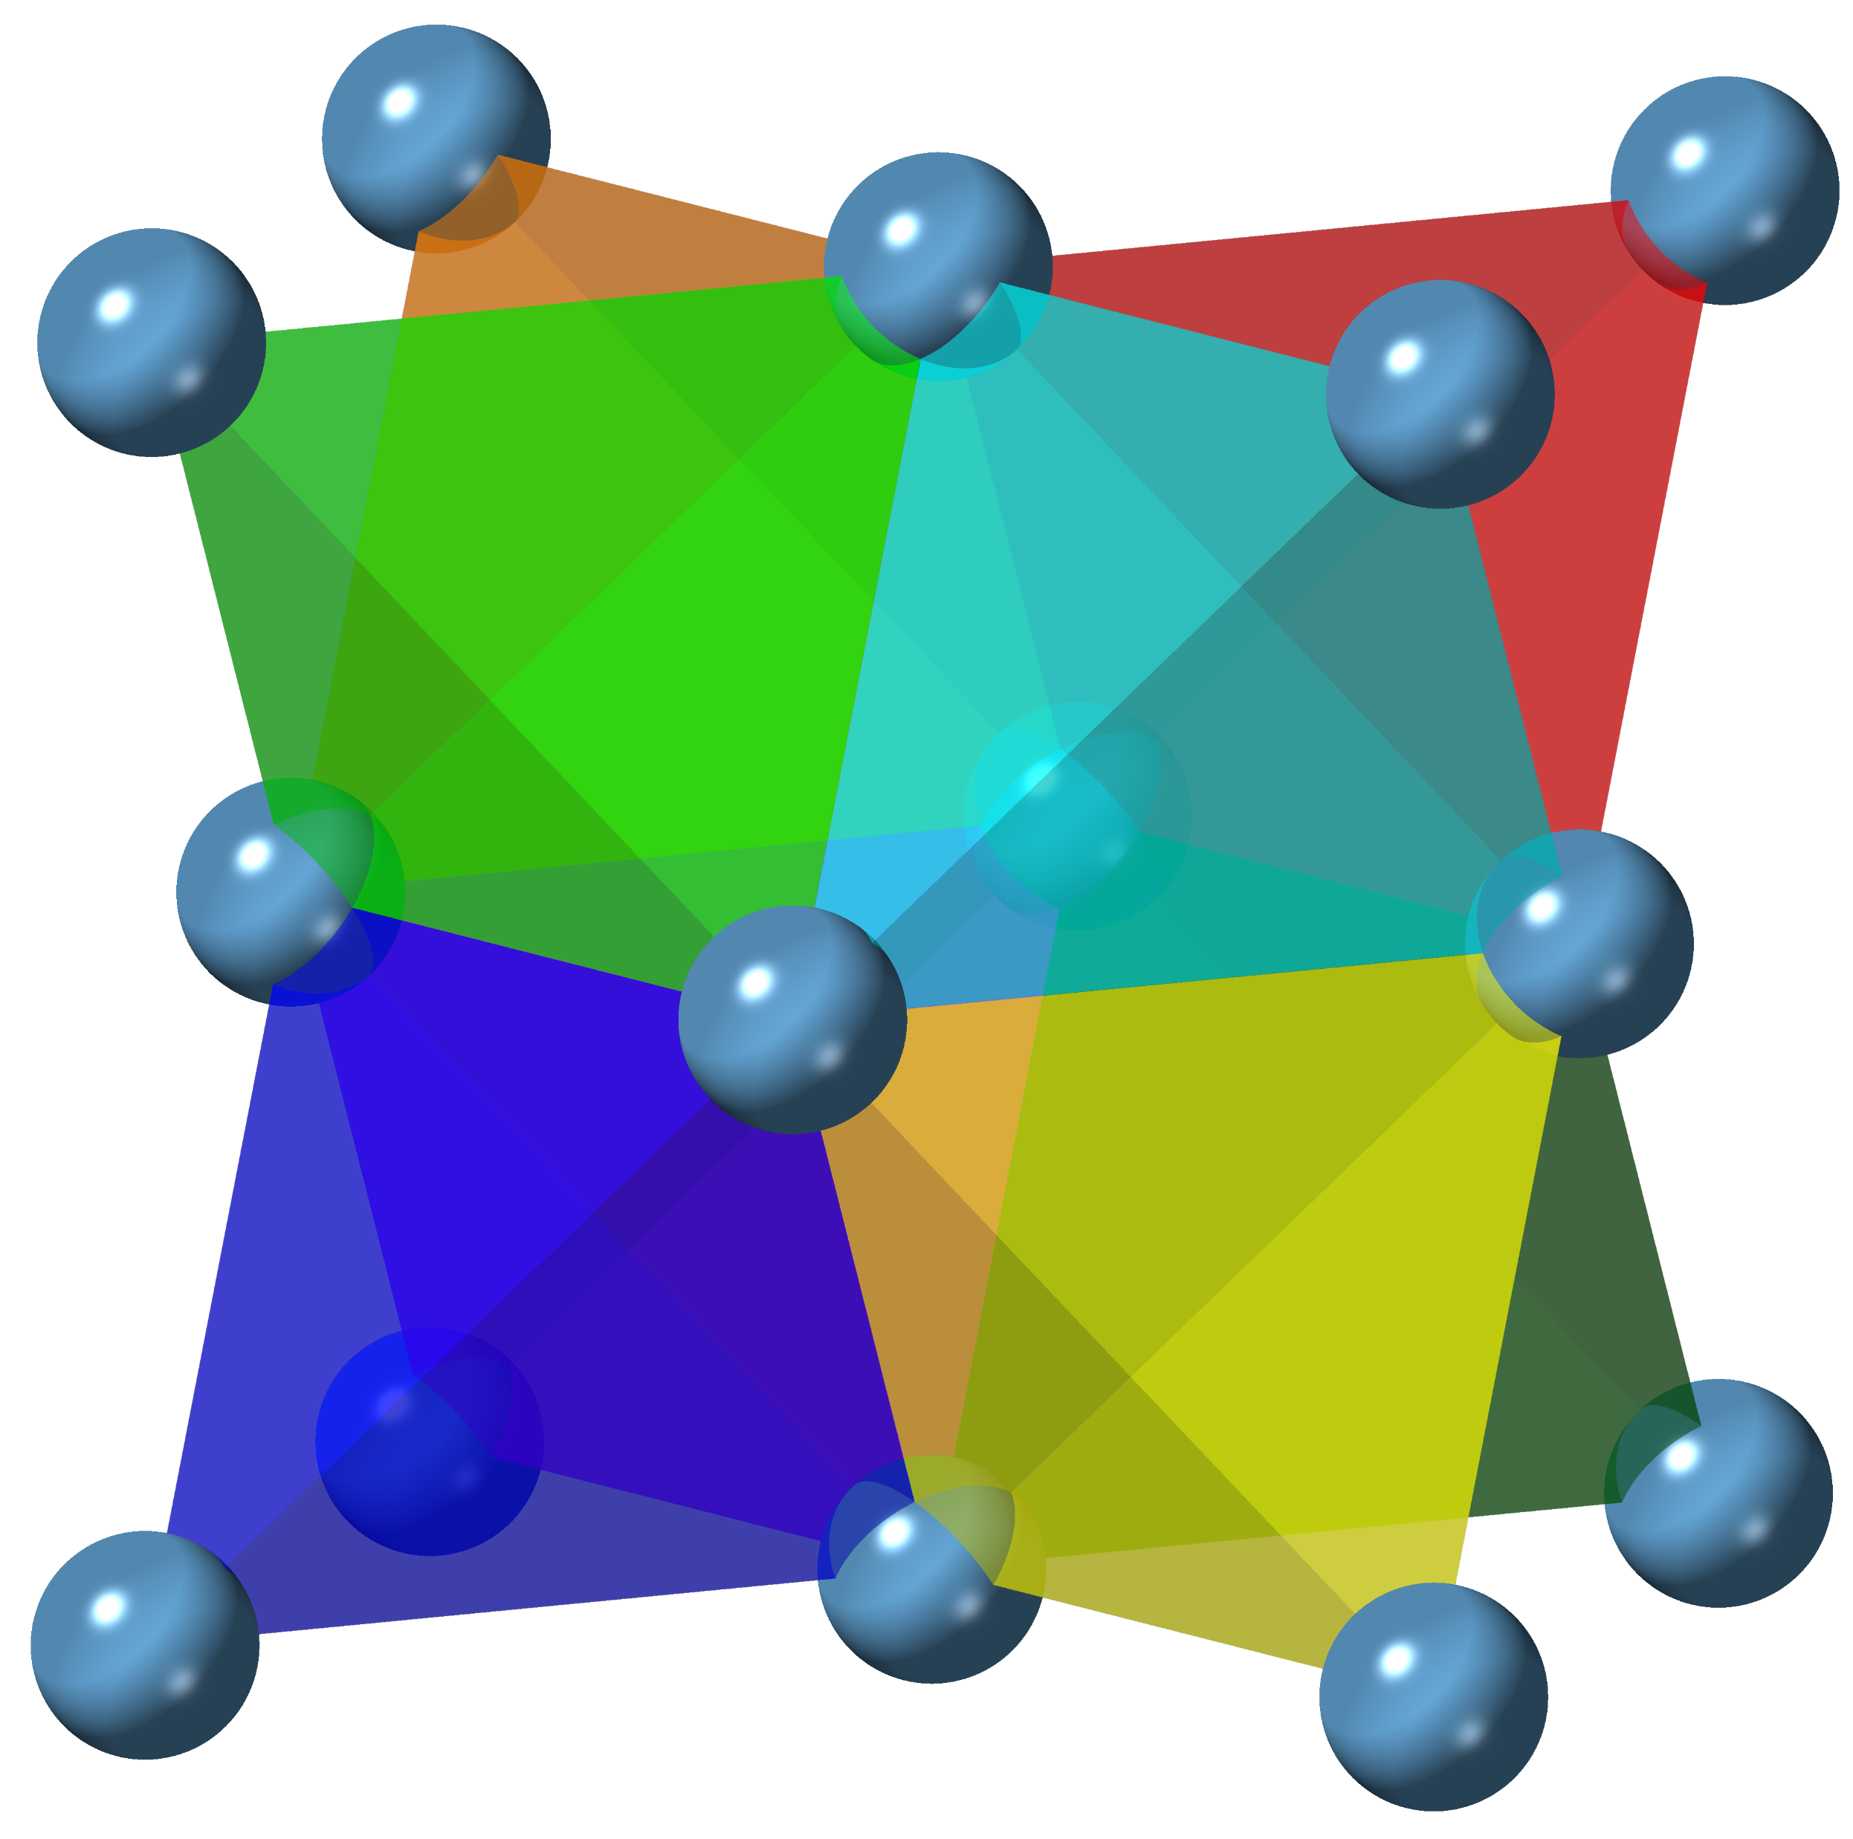
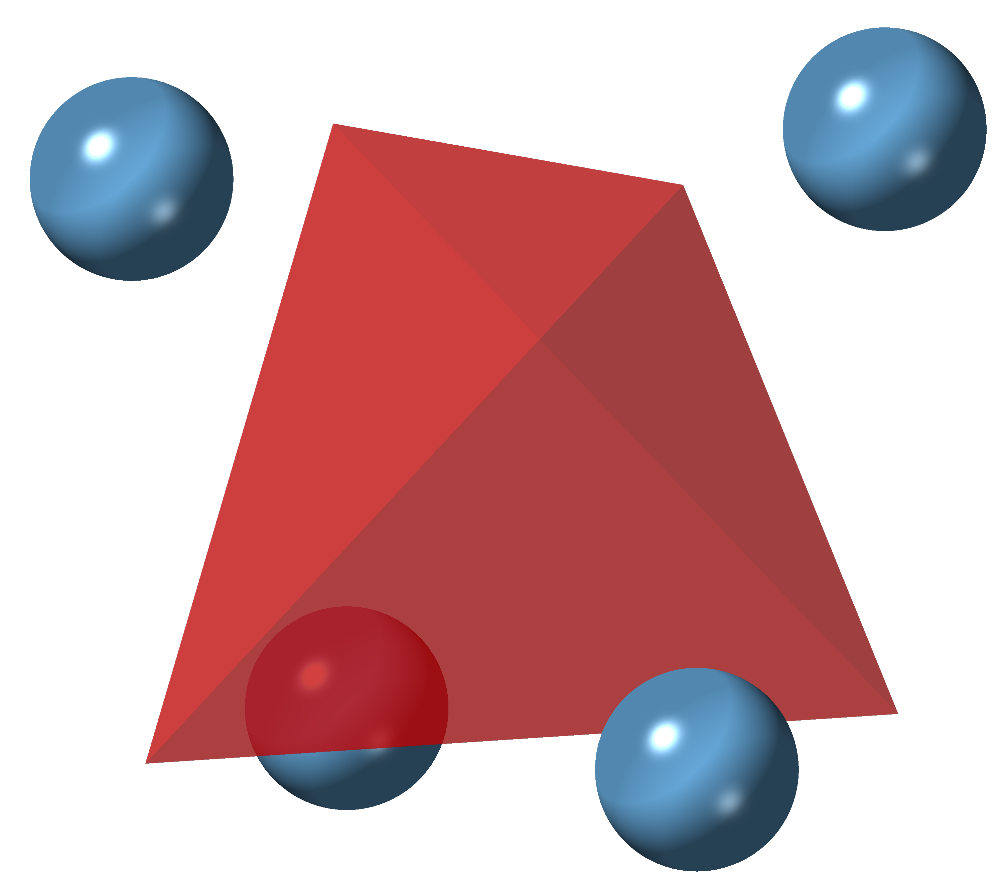
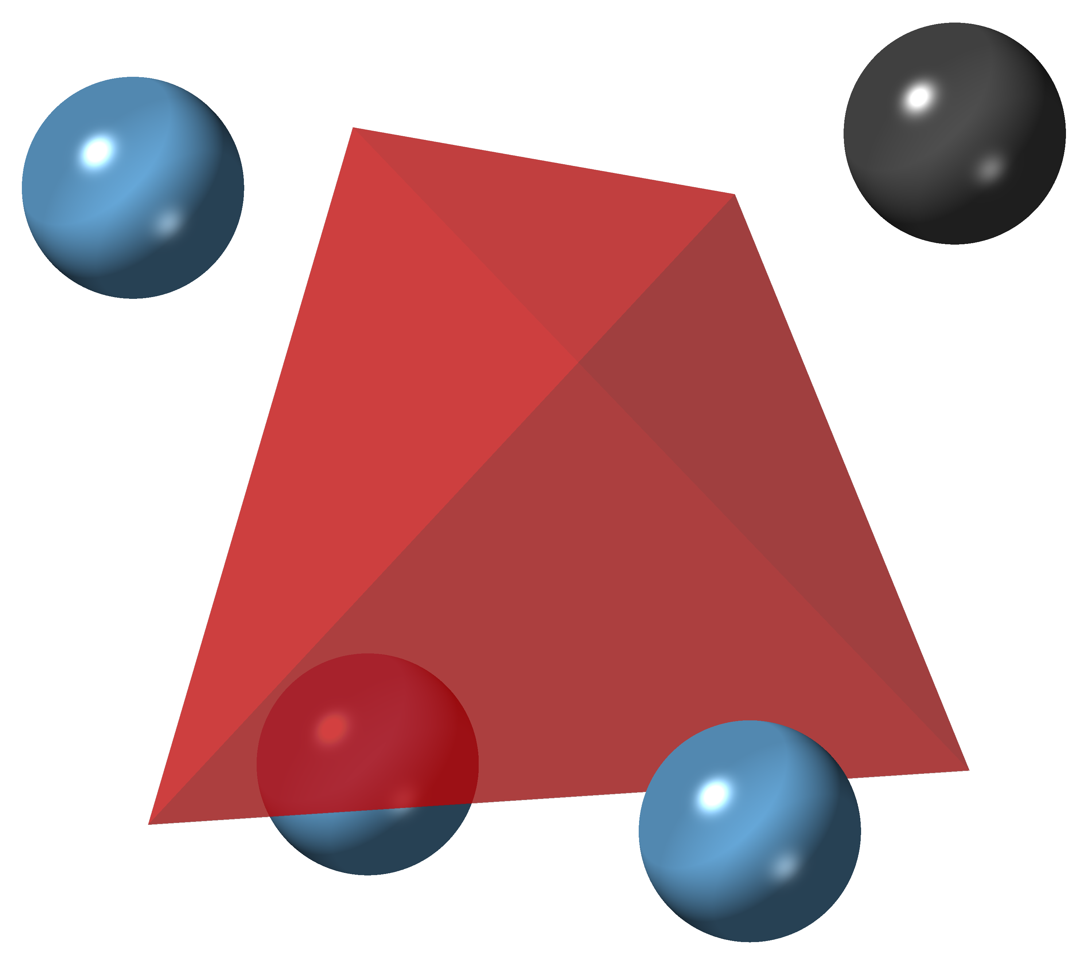
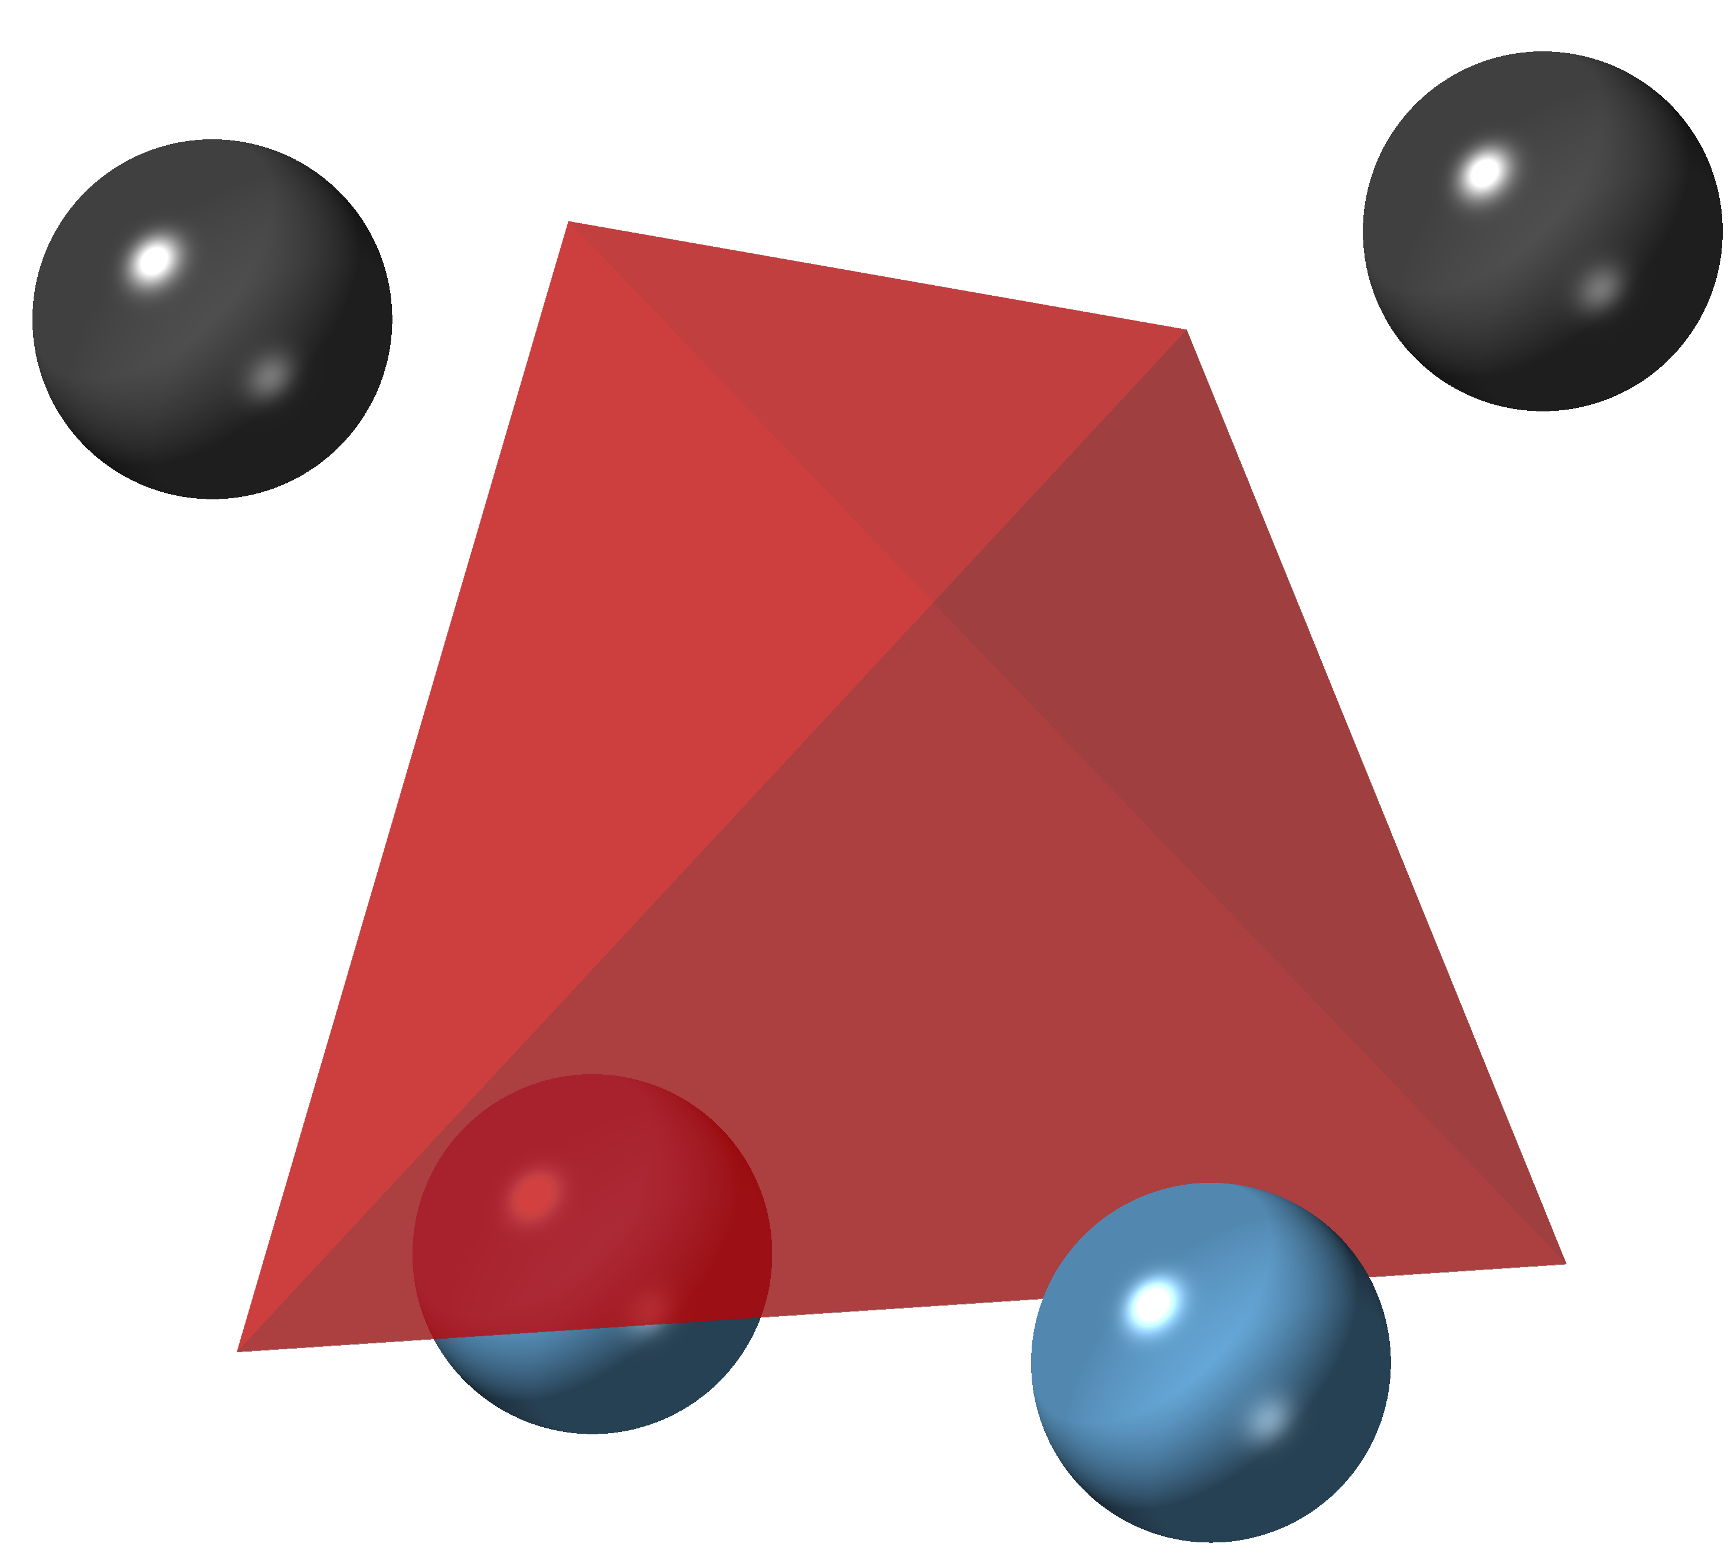
LTNNbOF – Basic structure building blocks
Li-TM Tetrahedron
Connectivity
Unit cell
Migration tetrahedron
0TM
1TM
2TM

Slide 16
LTNNbOF – Analysis for RMC configuration
Ratio of 0TM, 1TM and 2TM.
Connectivity/Correlation of 0TM, 1TM and 2TM.
Migration pathway/path-length.
Local correlation coefficient.
For the 1st one, the algorithm is simple, and will not be covered here in details.
For the 4th one, we have already got the codes, which will also not be covered here.
Slides following will focus on the 2nd and 3rd ones.

Slide 17
LTNNbOF – Connectivity/Correlation analysis
0TM
1TM
2TM
Abstraction/Mapping
A
B
C
Each migration tetrahedron will be abstracted as a single point and the whole structure just becomes a simple cubic lattice with each abstract point as the lattice point.

Slide 18
LTNNbOF – Connectivity/Correlation analysis
Shown in 2D space, the pattern will look something like this:
A
B
B
B
C
C
A
C
A
B
A
B
C
C
A
C
Correlation coefficient can then be calculated between A, B and C, using the same method as that is done for real atoms.

Slide 19
LTNNbOF – Migration pathway/path-length
Random walker algorithm for calculating migration pathway/path-length, again shown in
2D for clarity:
Starting from a random point (here, as indicated by the red circle), we randomly select a direction to walk. In the selected direction, we will come across with a certain barrier. Then we can roll the dice to determine whether or not we can walk through the barrier, based on the penetration probability which can be calculated as follows:
A
B
B
B
3
C
C
A
C
2
A
B
A
B
1
C
C
A
C
where is the migration energy barrier of a certain type of O tetrahedron (0TM, 1TM or 2TM).
Assuming we can walk through the selected neighboring tetrahedron, we count one step of successful walk, as indicated by the #1 polyhedron in the figure. Then we follow the same procedure to decide direction of next step walk and the corresponding chance of walking-through. Finally if we stop somewhere (i.e. the generated random number is smaller than the corresponding penetration probability for a certain walk-step), we can count how many

Slide 20
LTNNbOF – Migration pathway/path-length
steps we have been walking and also the effective walking distance along each direction.
Several things to point out here:
At each walking step, we may not want a backward walking, e.g. if we initially walk in +x direction (i.e. the very first occurrence of walking in x direction in the step series is to walk in +x), we may want to reject all –x walking in all the following steps. In this way, we can guarantee that Li+ is always walking forward.
The absolute value of energy barrier of each type of O tetrahedron may not matter that much. Supposing we have a whole bunch of RMC fits (say, for multiple datasets collected during charging), the only thing we are interested in is the comparison in between the series of RMC results but not the absolute value of each single dataset.
We can randomly select multiple, say, 1, 000 (or whatever suitable amount of) starting points for the random walk, through which we can then accumulate statistics.

Slide 21
LTNNbOF – RMC results
PDF, no fitted scale or offset
SofQ, fitted scale and offset
Move only – For fitting statistics, refer to later slides.

Slide 22
LTNNbOF – RMC results
PDF, no fitted scale or offset
SofQ, fitted scale and offset
Move & Swap – For fitting statistics, refer to later slides.

Slide 23
LTNNbOF – RMC fitting statistics
 | PDF | SofQ | Bragg | BVS
Move only | 0.824E-02 | 0.161E-04 | 0.509E-02 | 0.881E+02
Move & Swap | 0.317E-02 | 0.747E-02 | 0.413E-02 | 0.875E+02
Chi square statistics of two RMC fittings. Here for ‘move & swap’ fitting we have the swap probability: Li-TM=0.05, O-F=0.005

Slide 24
LTNNbOF – RMC to-dos
Try fit scale only for S(Q) dataset (currently we fit both scale and offset) => ongoing on NIST cluster (try6).

